Slide 1
物聯網實務 HW11
電機碩一 11278008 林佳慧
日期:2023/11/29

Slide 2
Exercise 11-1
ex11_29_1.html (copy from ex11_29_1.txt)

Slide 3
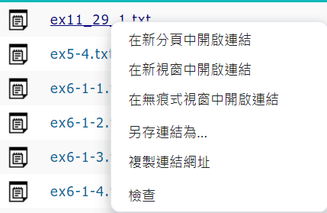
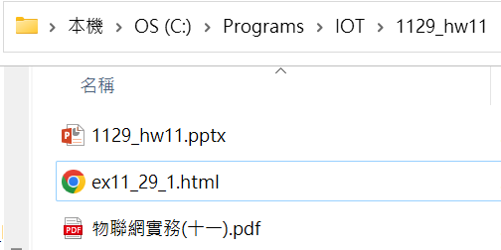
2. 儲存成html & 開啟檔案
1. Save as

Slide 4
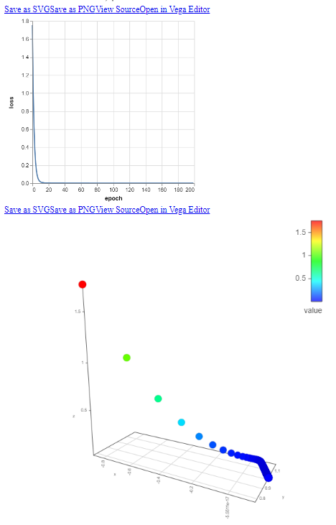
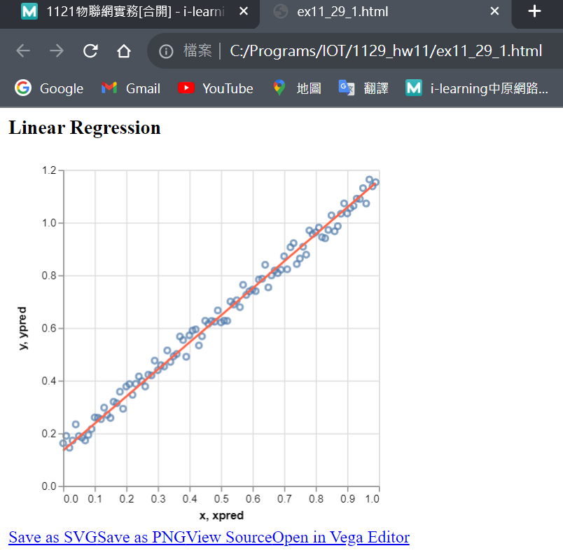
Result

Slide 5
Exercise 11-2
ex11_29_1.html
• (copy from ex1129_.txt)
• Ping pong game

Slide 6
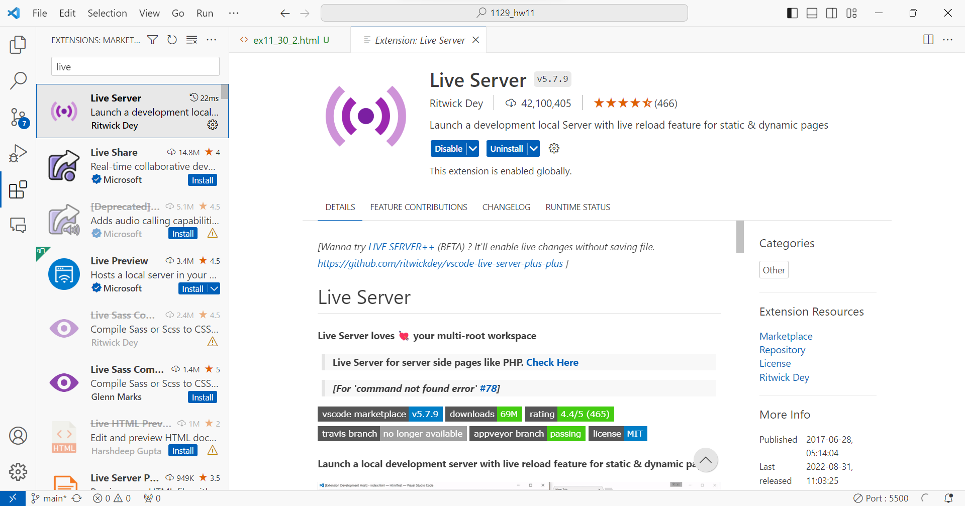
安裝Live Server。在vsc修改，網頁也會即時更新。

Slide 7
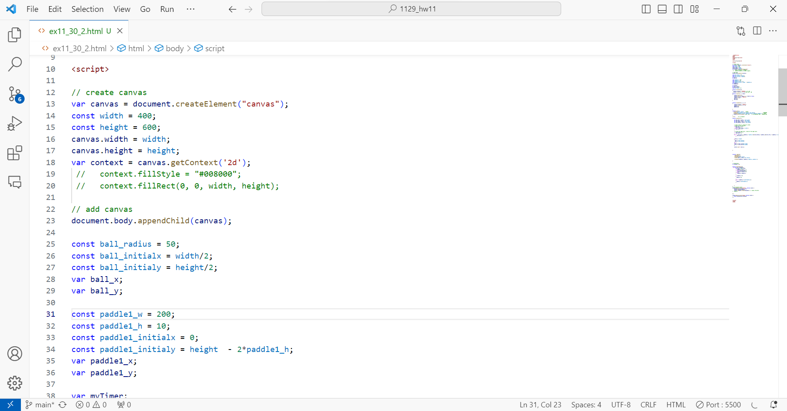
可更改球的半徑、速度，paddle的寬度等等

Slide 8
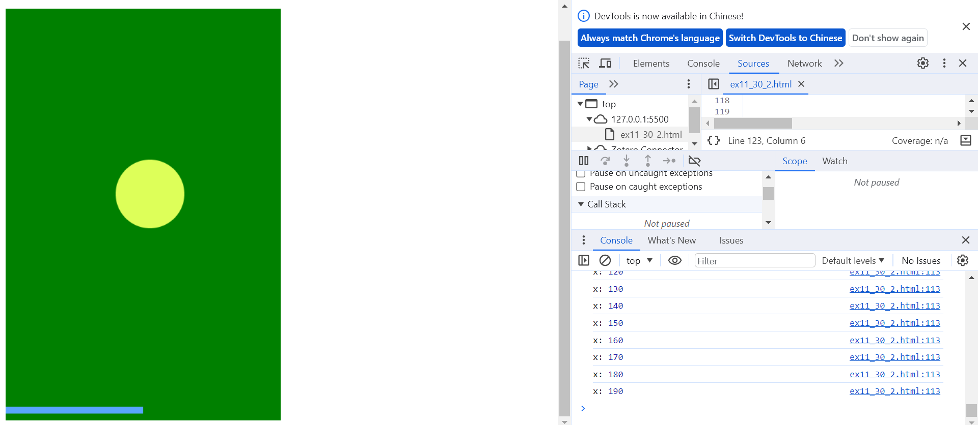
Console視窗
球
球x座標
球拍

Slide 9
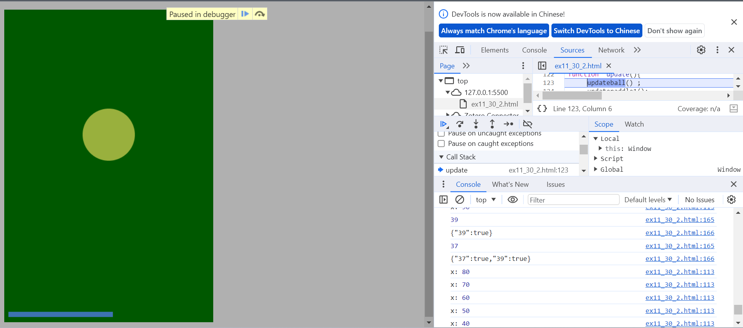
按鍵代碼
KeysDown內容

Slide 10
Exercise 11-3
ex11_29_3.html
• (copy from ex11_29_3.txt)
• Record playing data

Slide 11
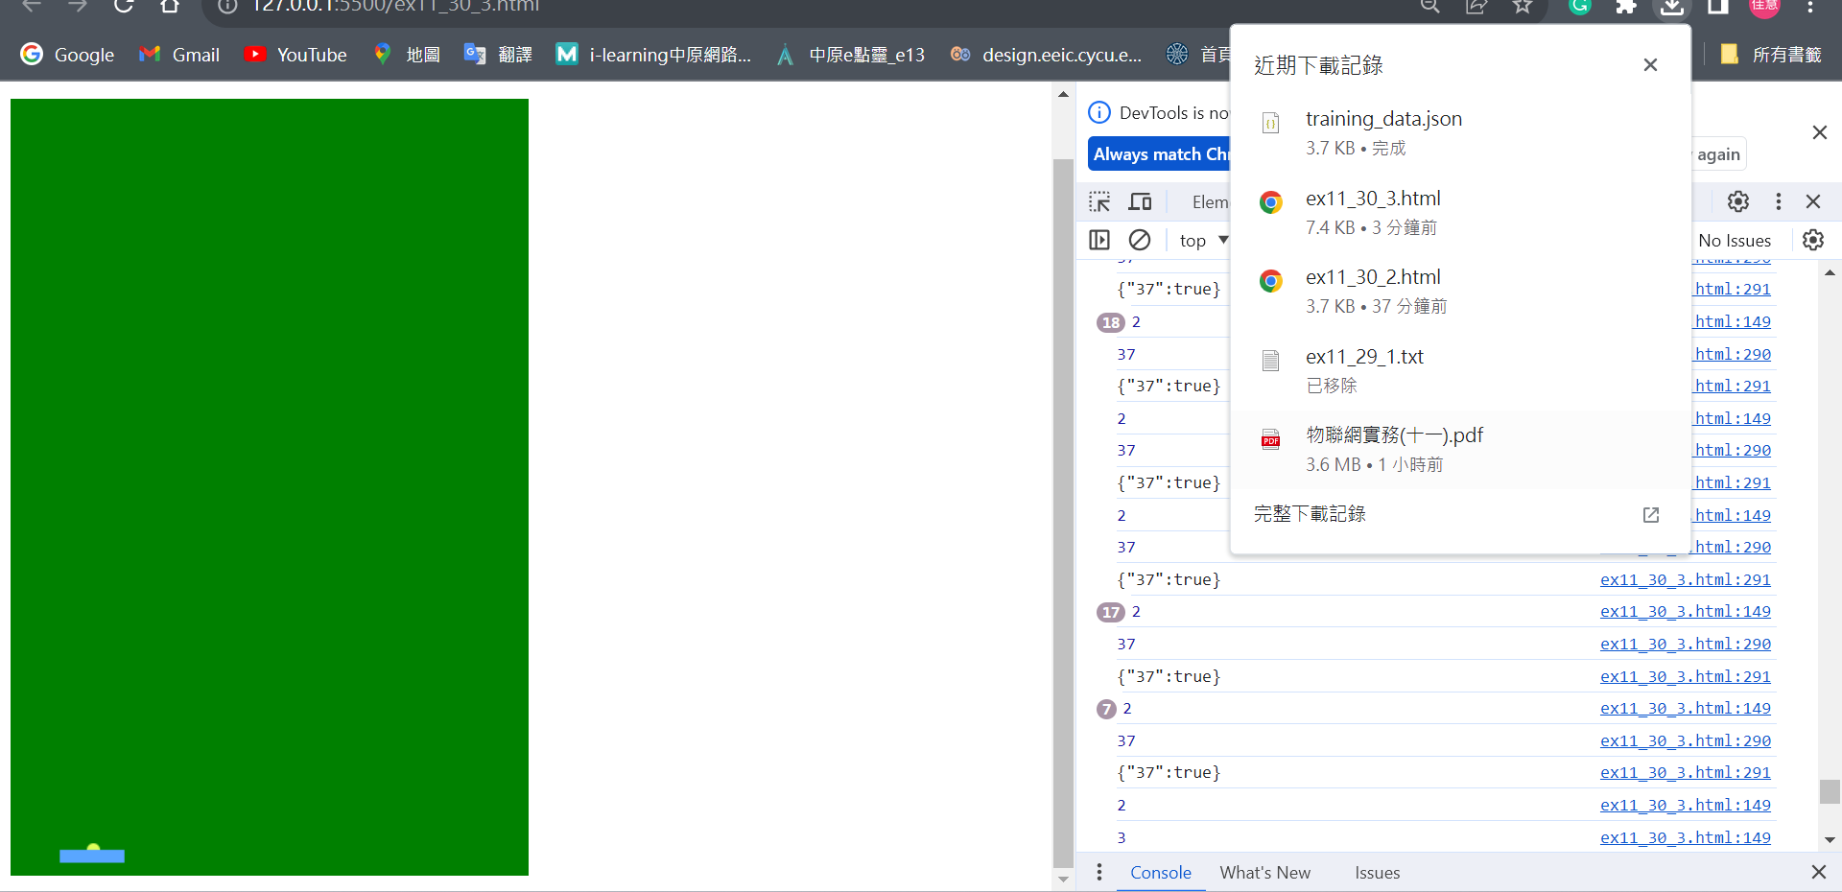
擊到3次自動下載
擊到球

Slide 12
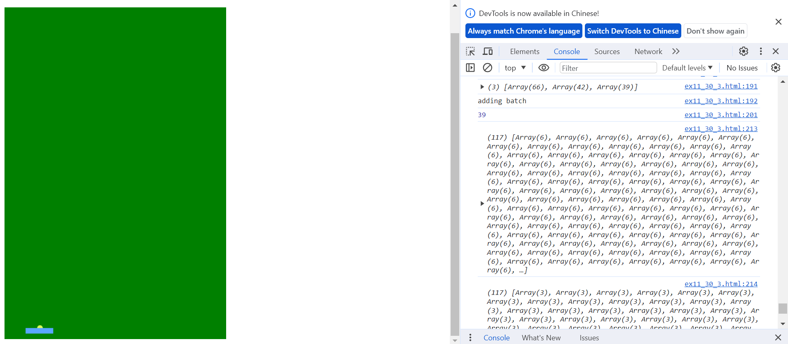
目前累積紀錄
三類記錄中最少之筆數

Slide 13
Exercise 11-4
ex11_29_4.html
• (copy from ex11_29_4.txt)
• Train model

Slide 14
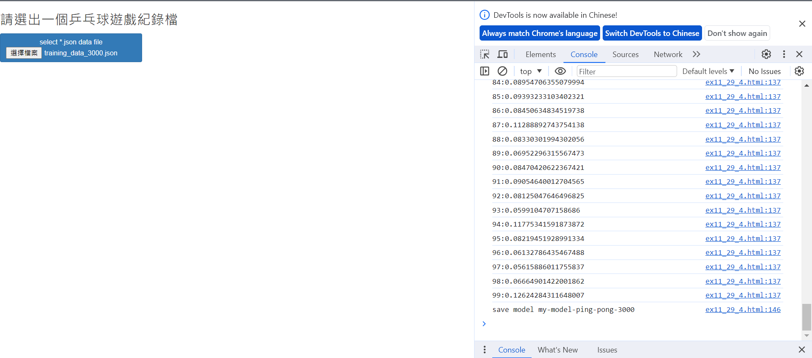
F12
1.選擇檔案
儲存模型

Slide 15
Exercise 11-5
ex11_29_5.html
(copy from ex11_29_5.txt)
AI play ping pong game

Slide 16
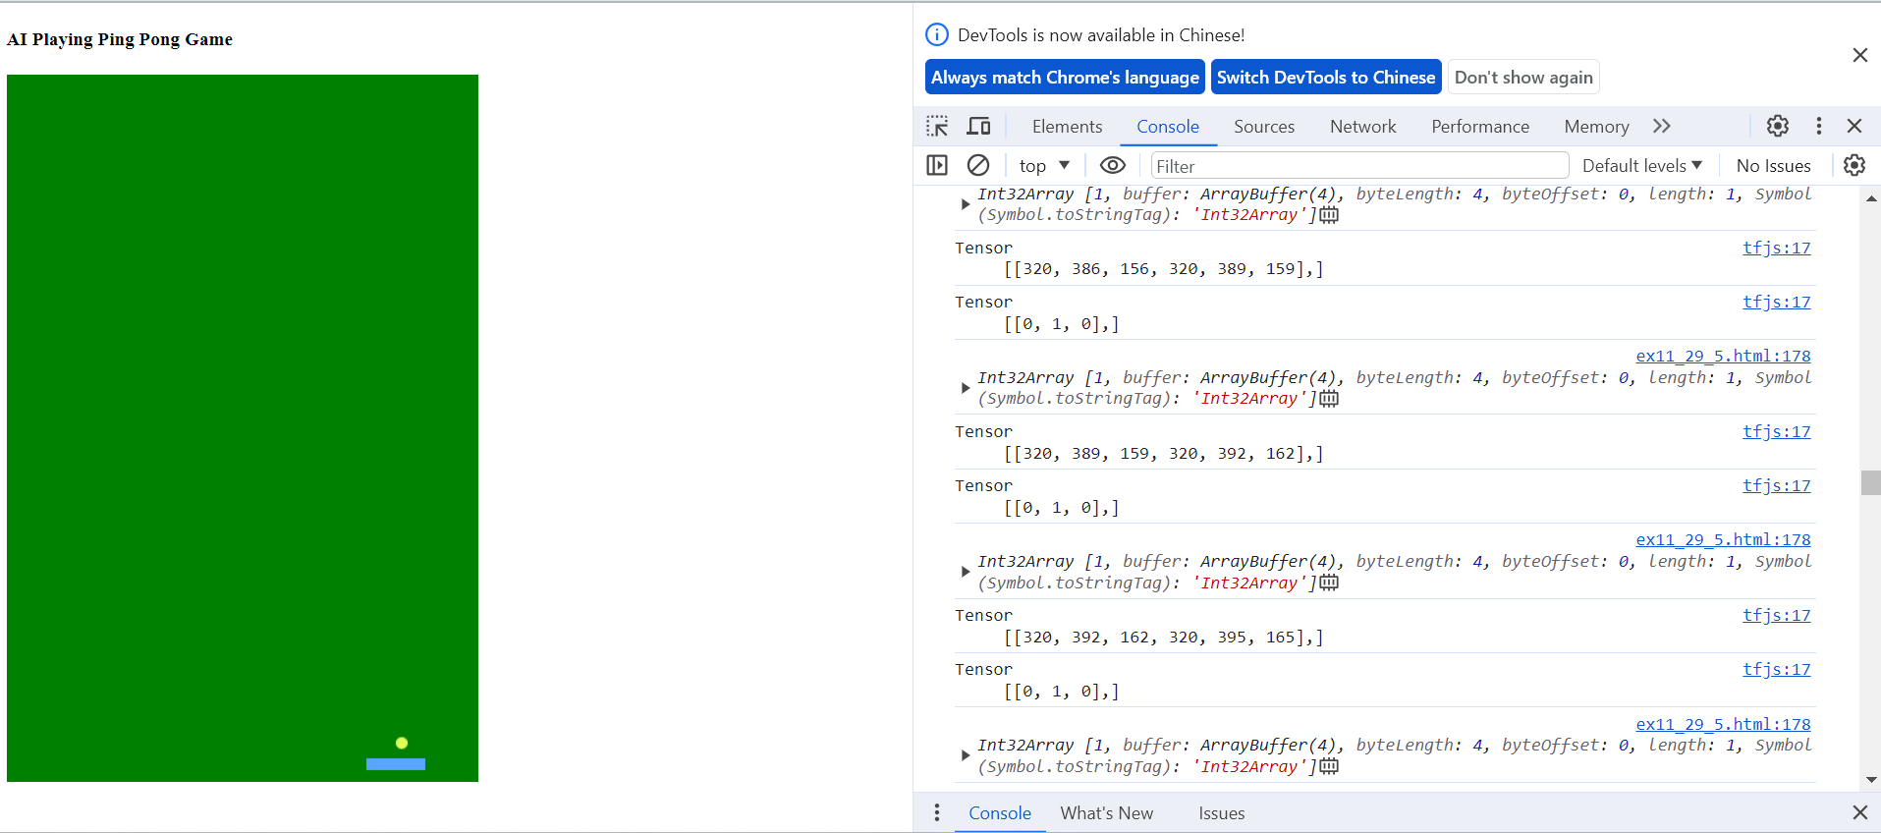
從ex11-4的訓練模型，AI會自己打乒乓球

Slide 17
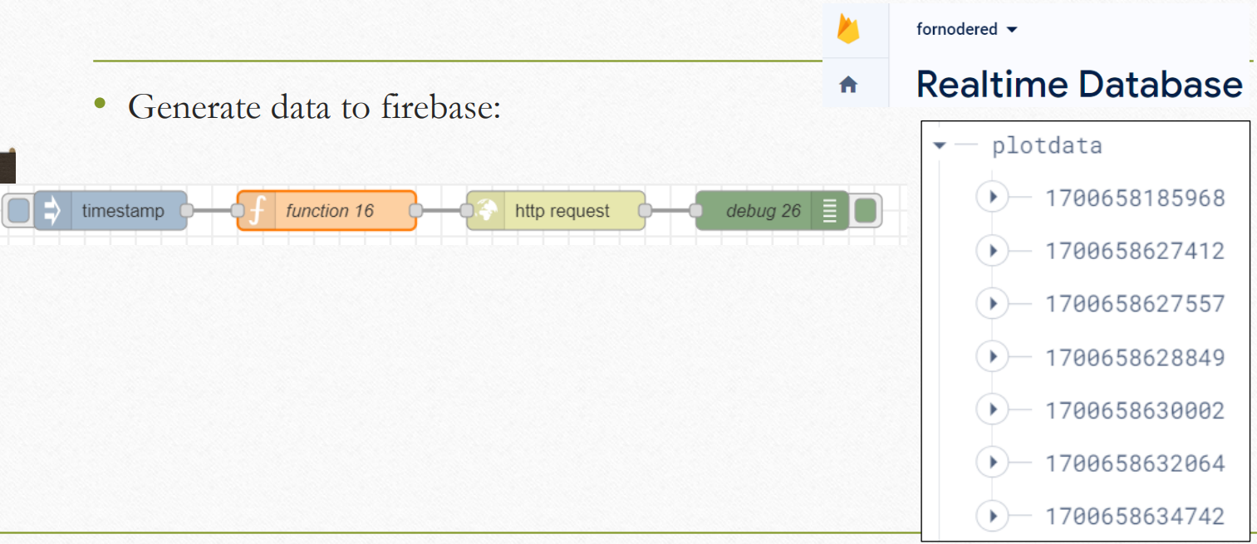
Exercise 11-6

Slide 18
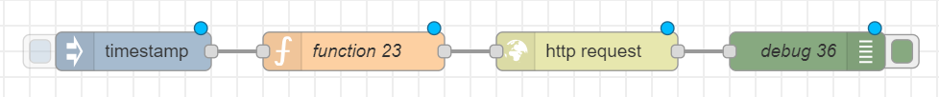
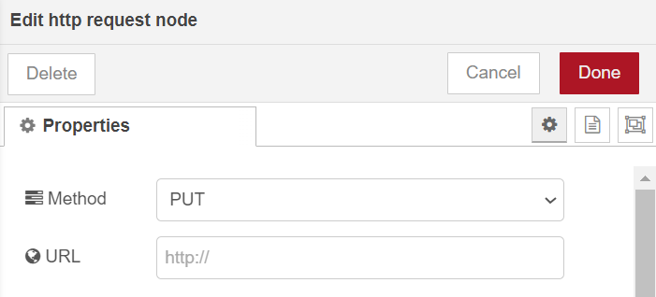
Generate data to firebase
let data = Math.round((Math.random()*100));
const d = new Date();
var timestamp = d.getTime();
var time = d.toDateString() + " " + d.getHours()
+ ":" + d.getMinutes() + ":" +
d.getMinutes() + ":" + d.getSeconds();
msg.url="https://totoras-57d56-default-rtdb.firebaseio.com/plotdata/"+timestamp+".json";
msg.payload = { "data": data, "time": time };
return msg;
PUT

Slide 19
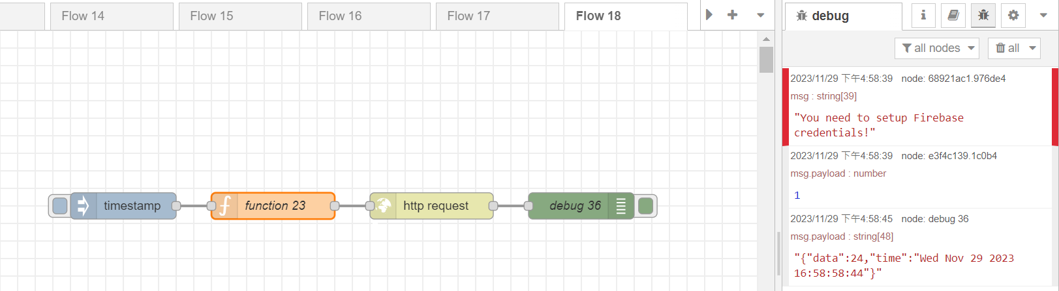
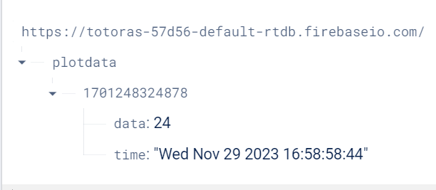
Trigger
hit
隨機產生data

Slide 20
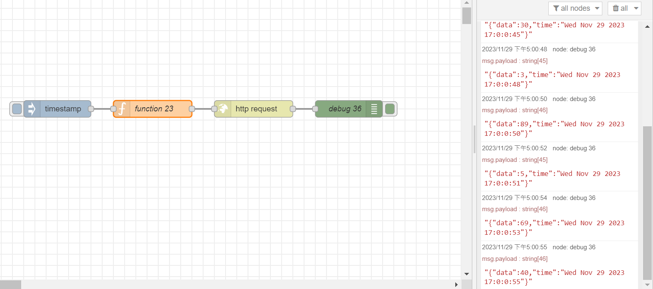
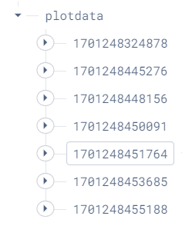

Trigger 6 times
hit

Slide 21
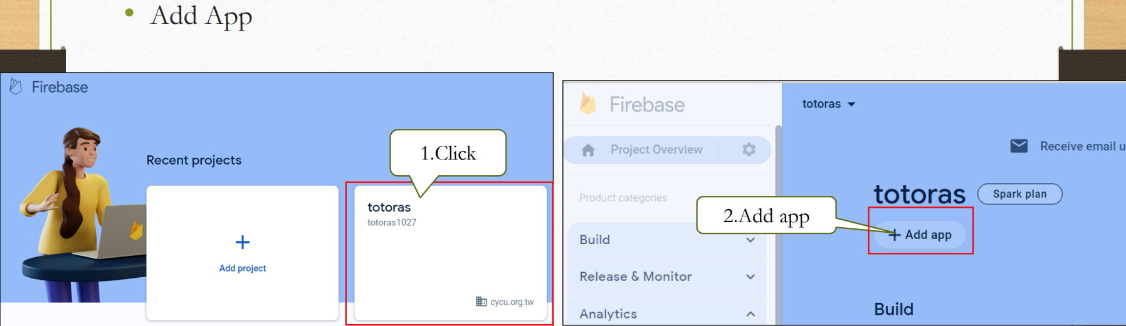
Exercise 11-7

Slide 22
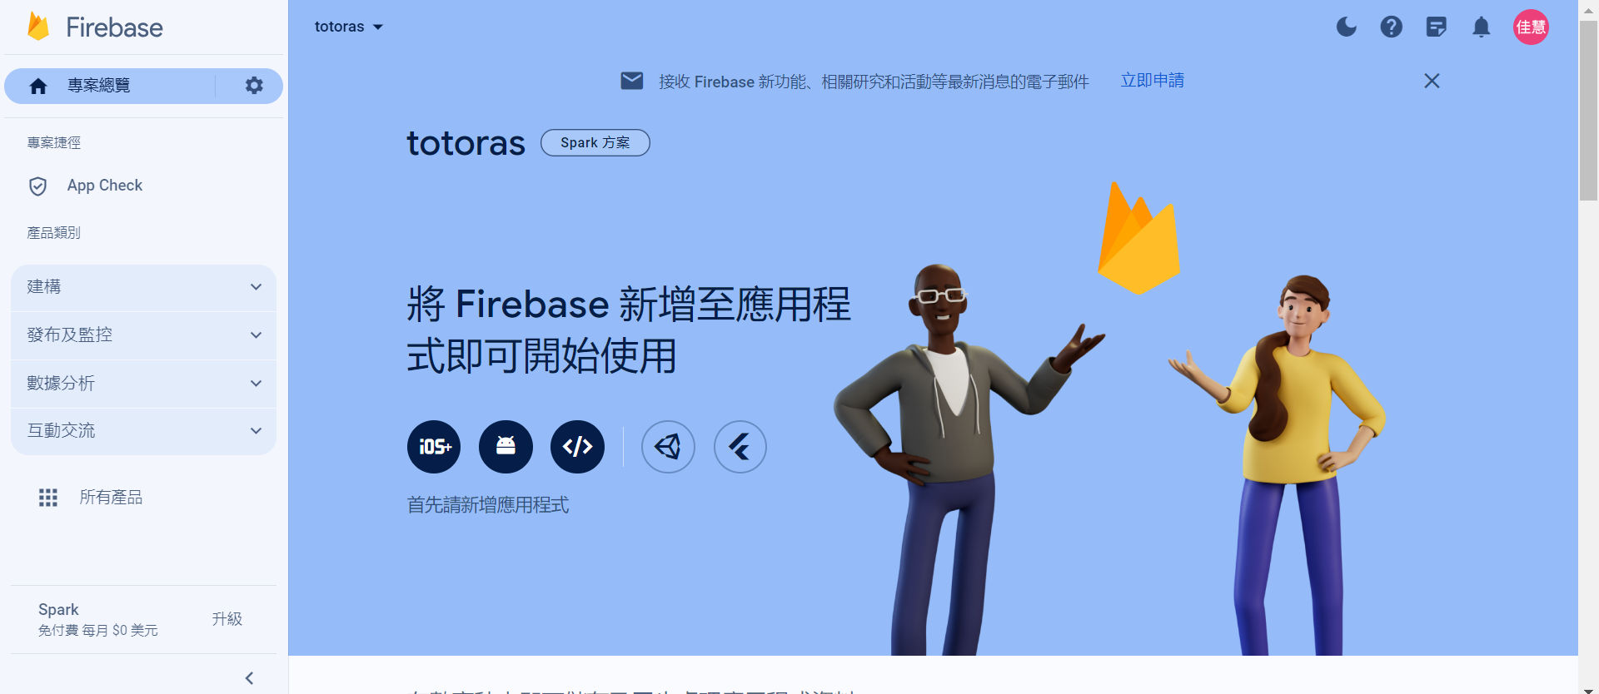
Add Web
Web

Slide 23
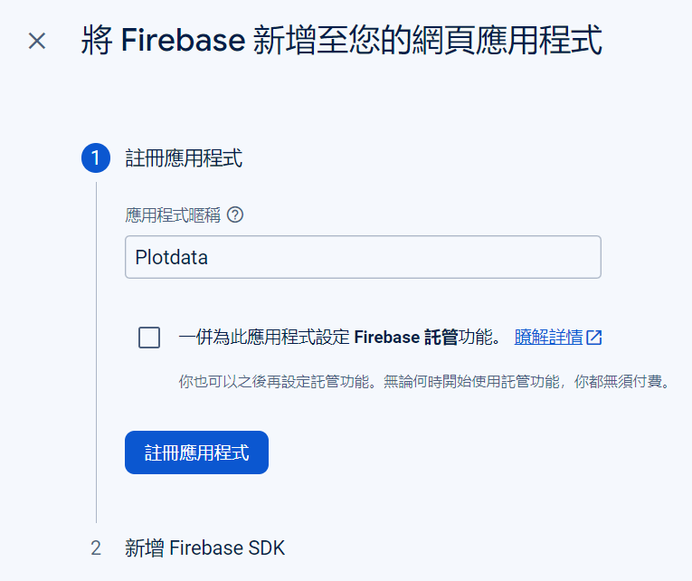
Plotdata
2

Slide 24
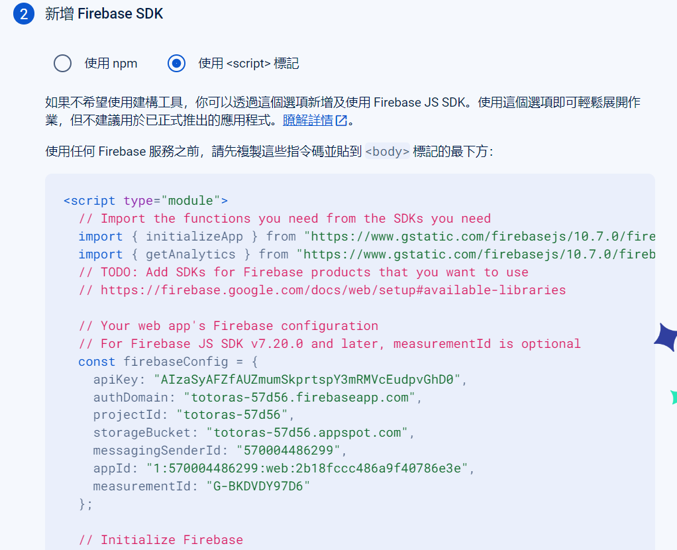
Use a <script> tag
Copy

Slide 25
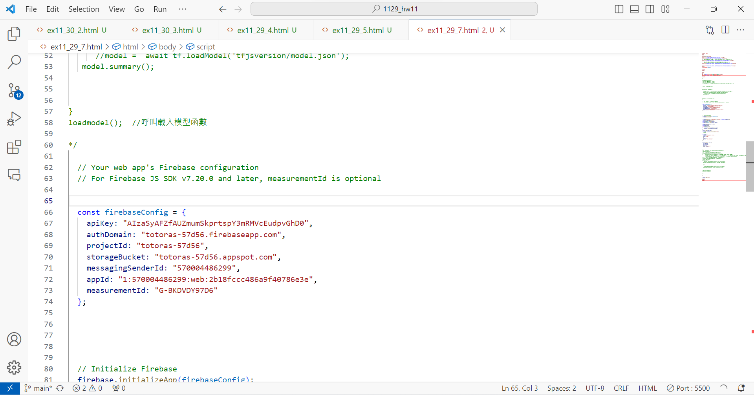
Paste and save to ex_11_29_7.html
Paste

Slide 26
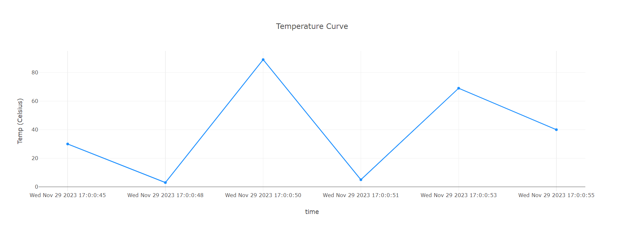
Result

Slide 27
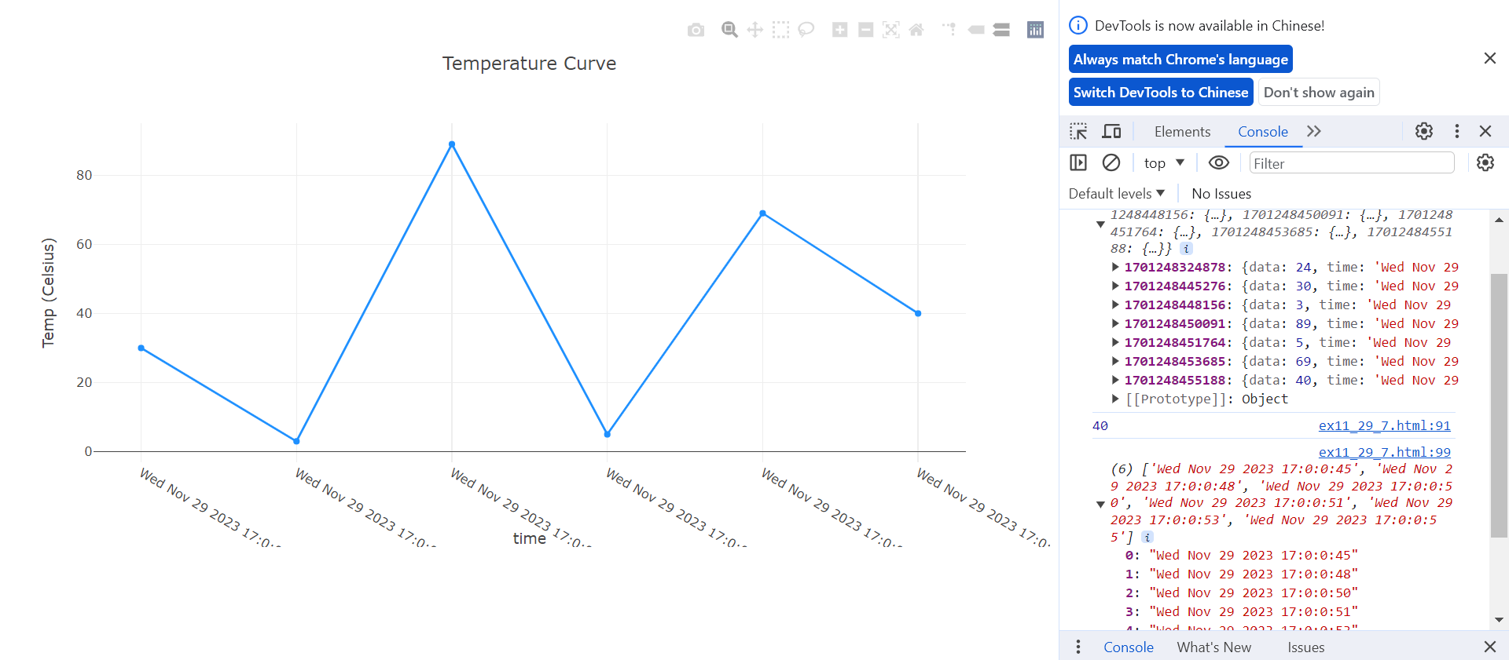
F12

Slide 28
Exercise 11-8
Training Model
ex11_29_8.html
(copy from ex11_29_8.txt)

Slide 29
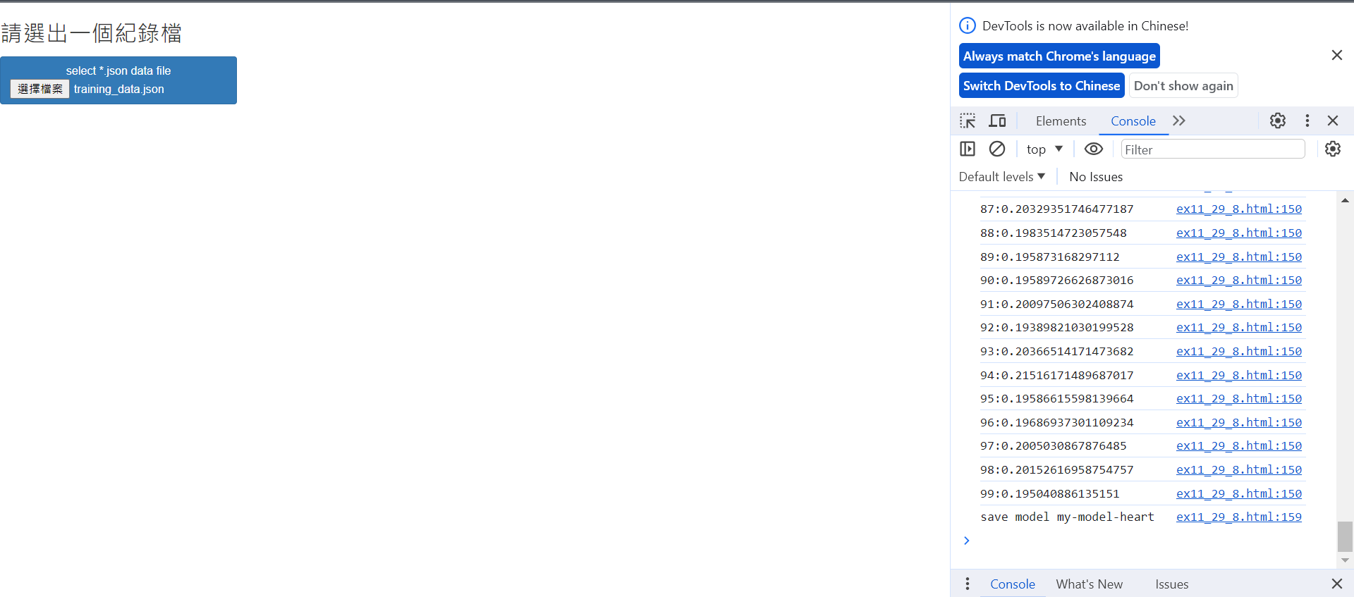
1. Choose training_data.json
Save model

Slide 30
Homework 11-1
change code: when the length of the record is larger than 100, the json file
will be downloaded automatically

Slide 31
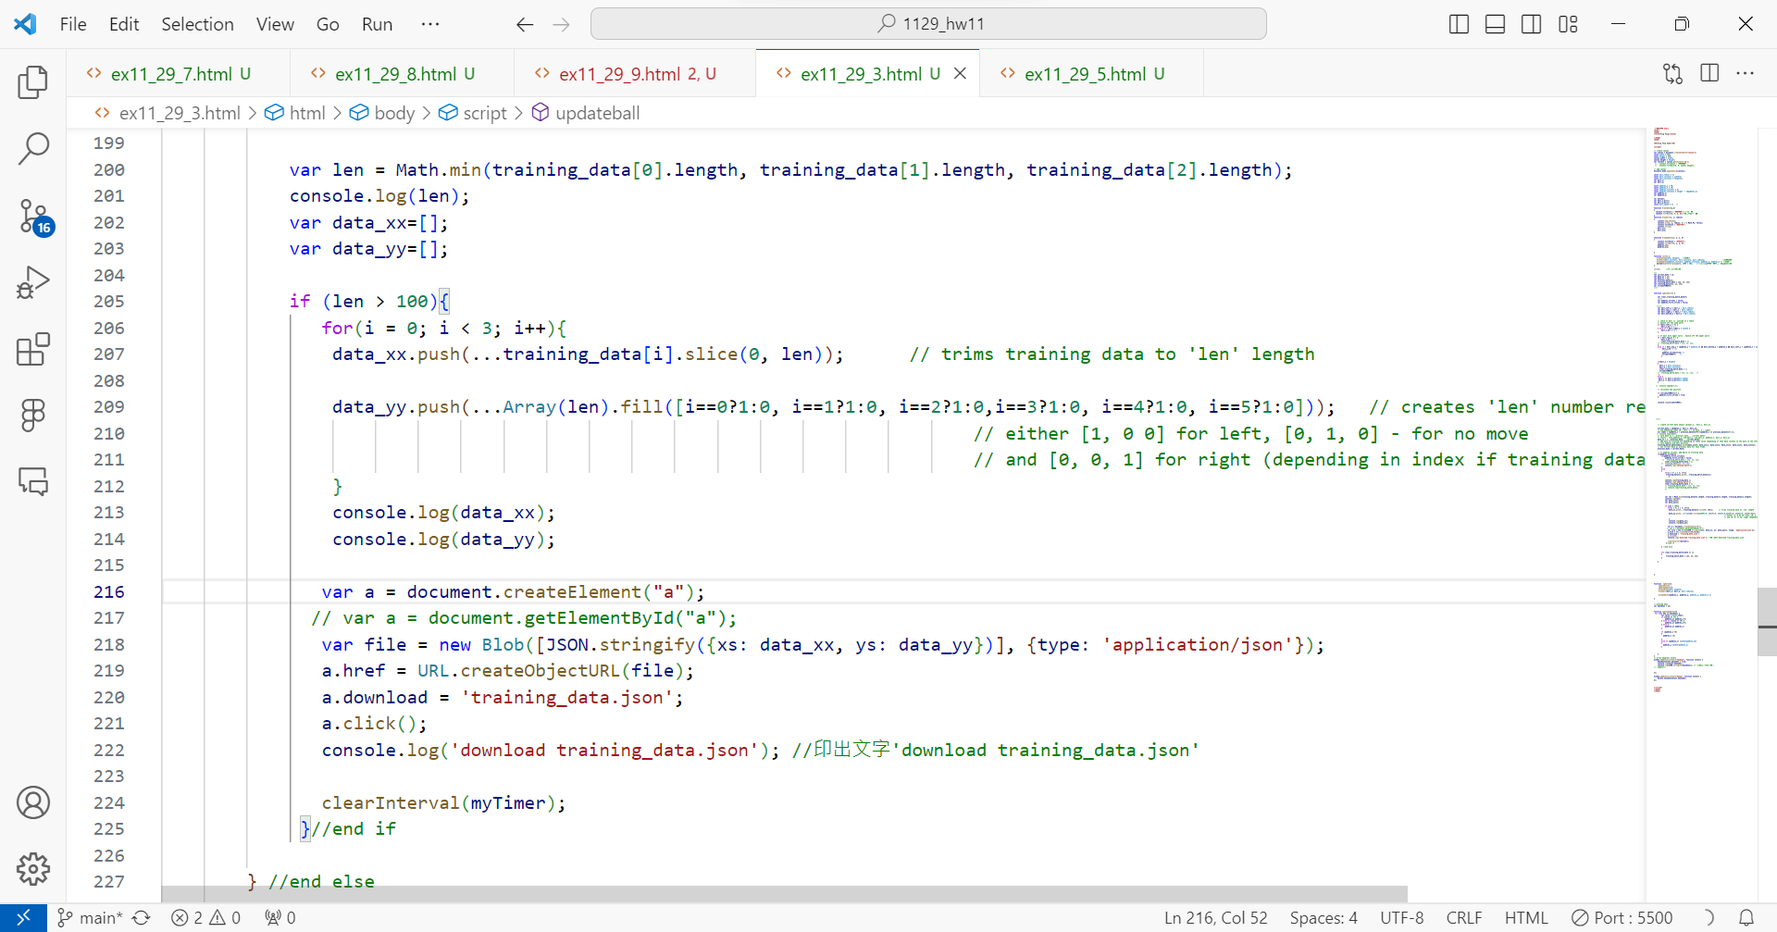
將值更改為100

Slide 32
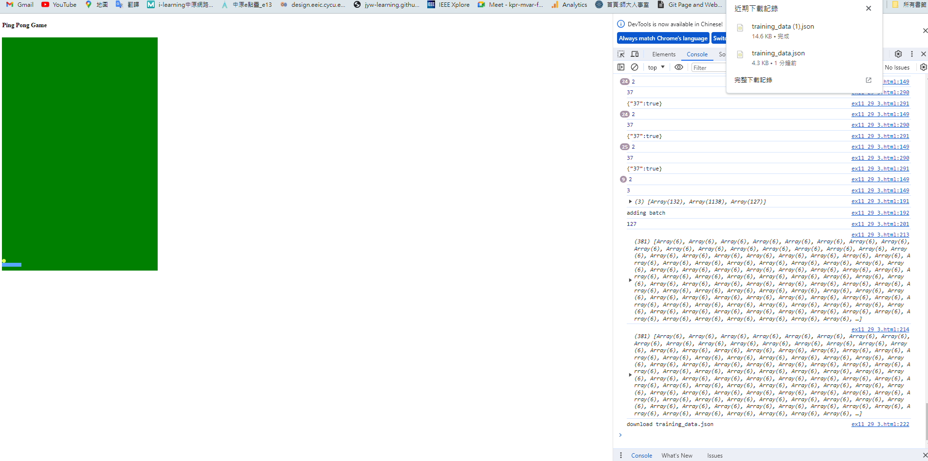
len
如果len>100，則將訓練數據裁剪為len長度。

Slide 33
Homework 11-2
Open “ex11_29_7.html” and save as “ex11_29_9.html”
Delete /* */
/* */

Slide 34
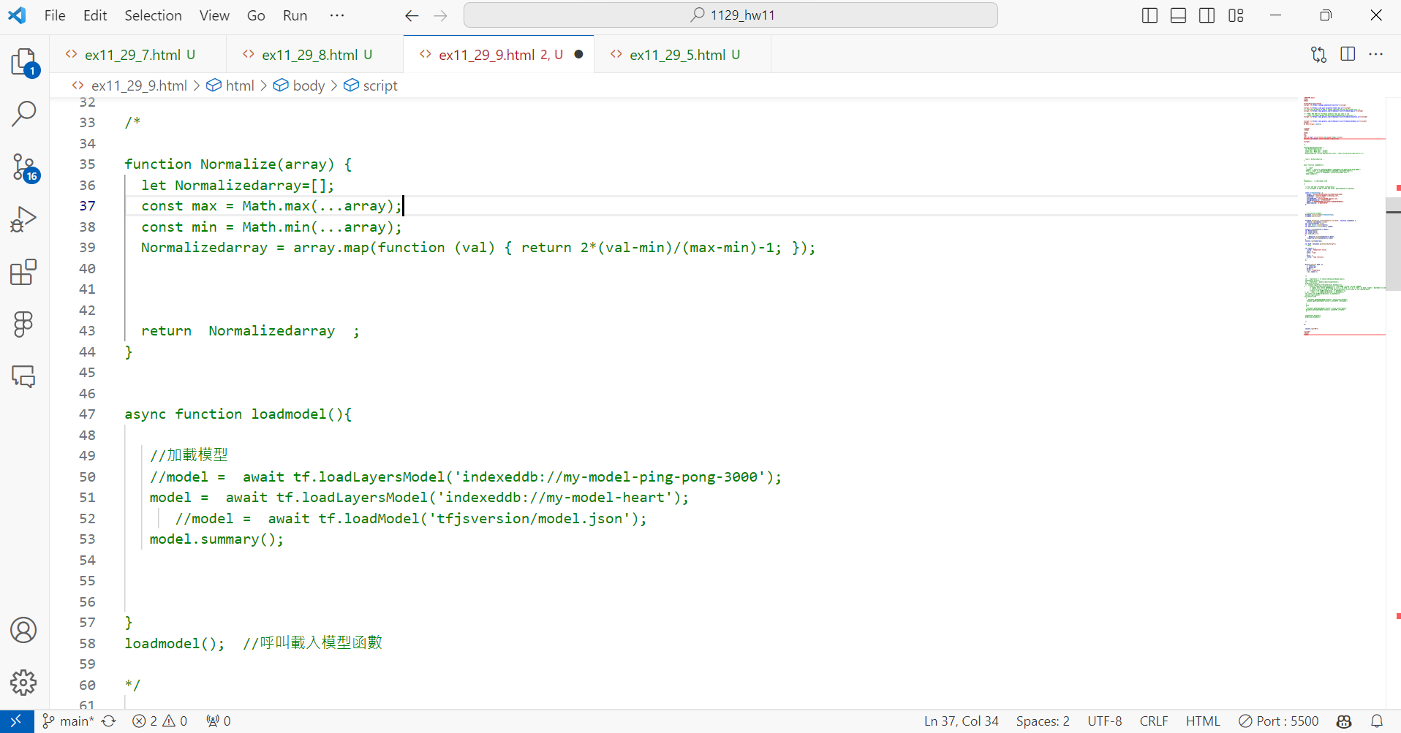
將註解拿掉

Slide 35
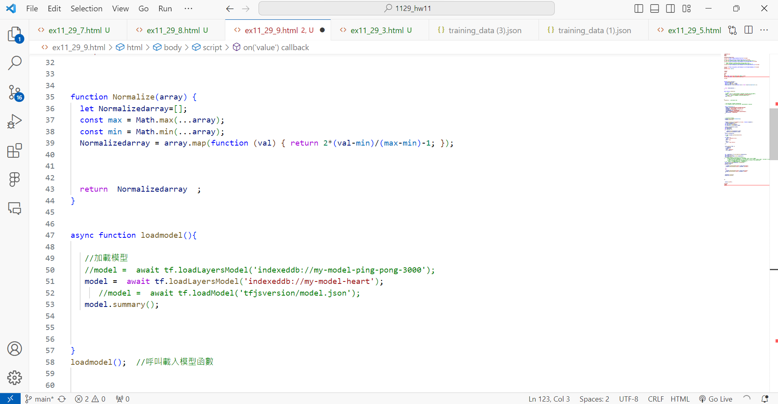

Slide 36
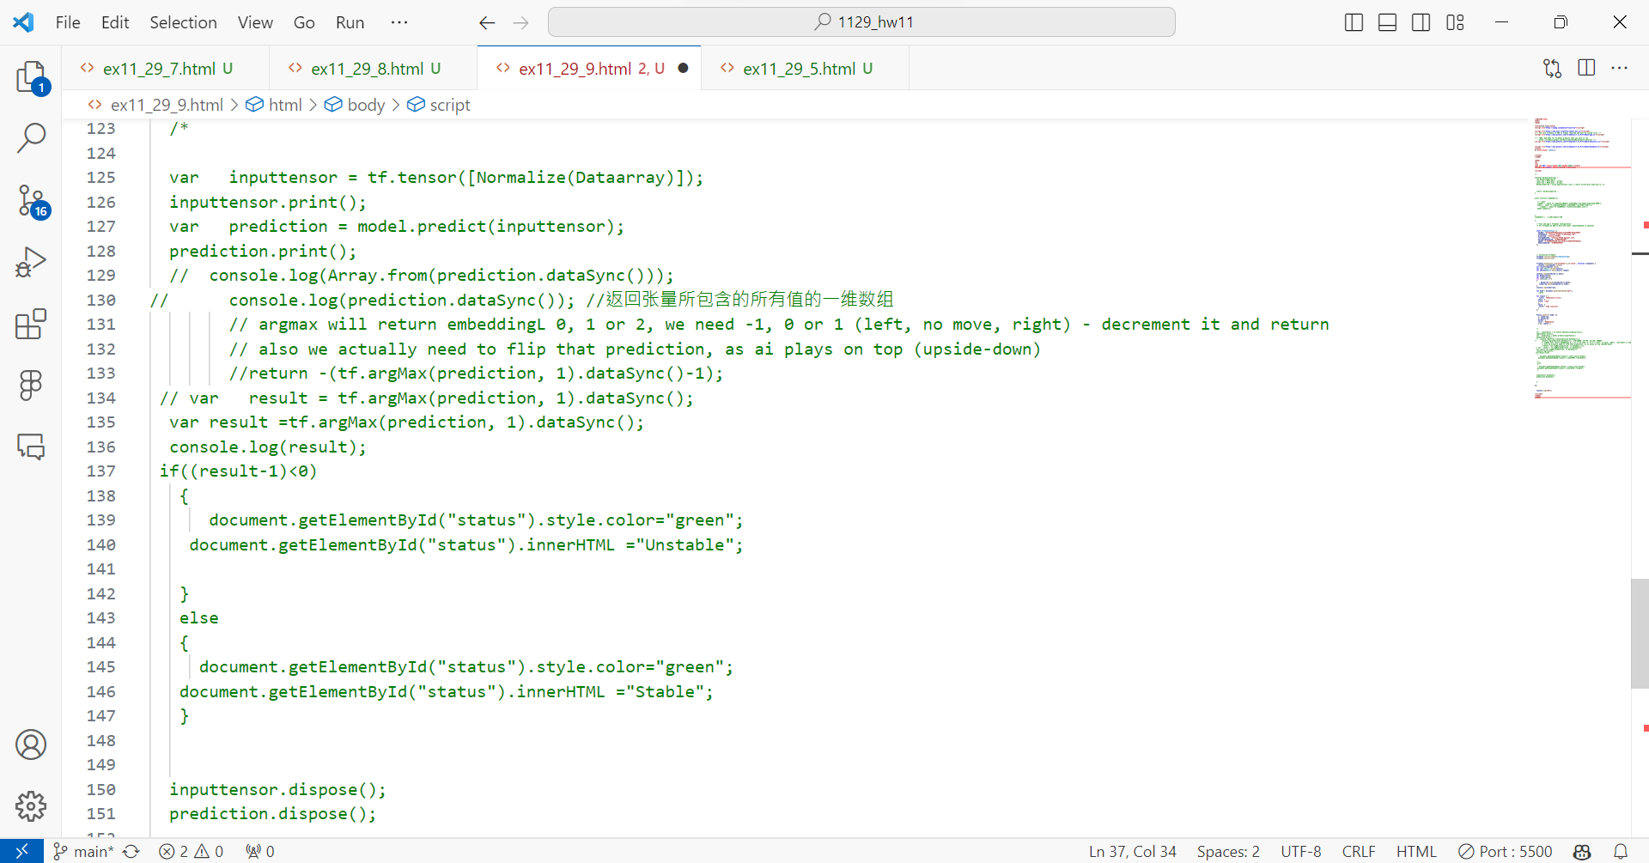
將註解拿掉

Slide 37
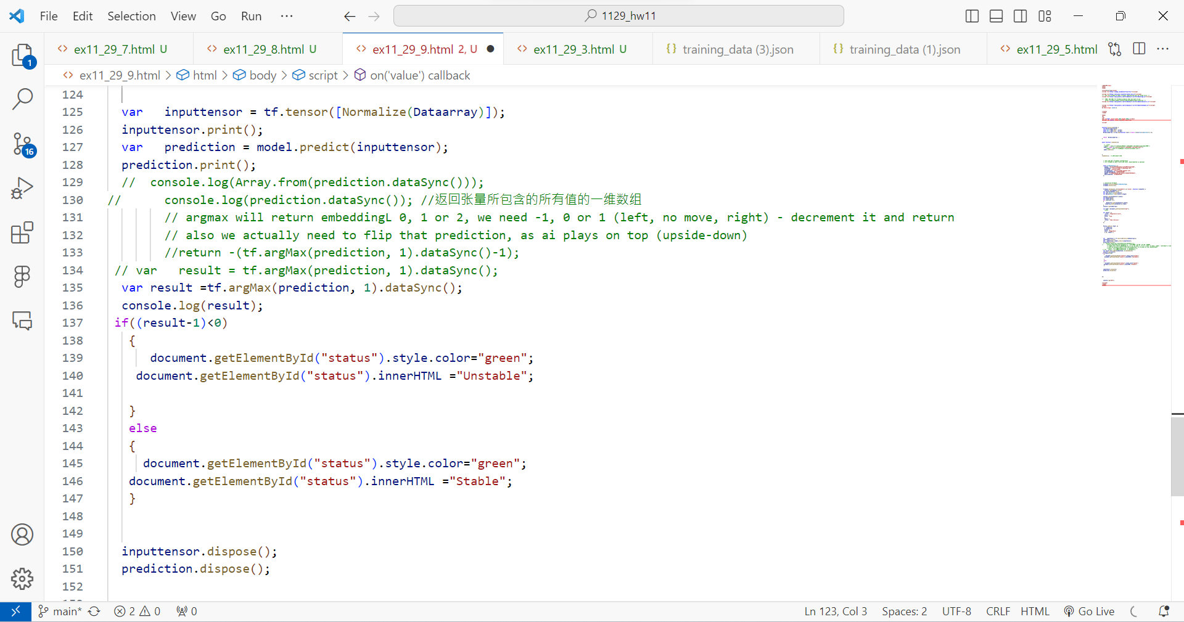

Slide 38
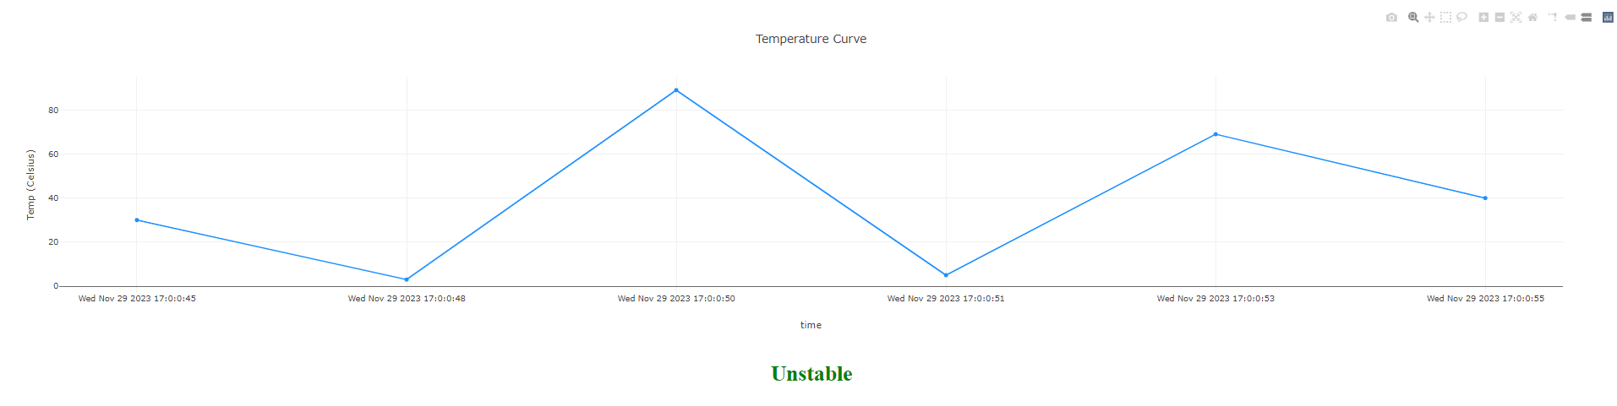
Result

Slide 39
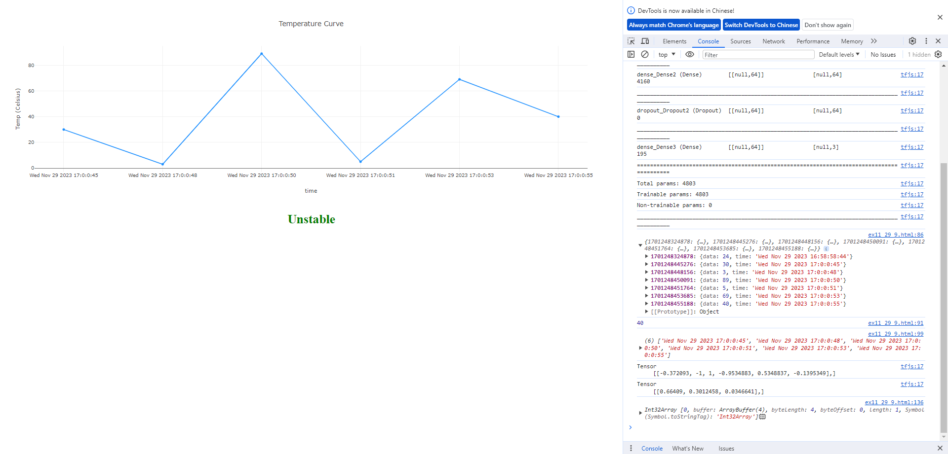
Result

